Slide 1
Employee Data Analysis using Excel
STUDENT NAME: RUBHA R
REGISTER NO:312210049
DEPARTMENT: BCOM GENERAL
COLLEGE: VALLIAMMAL COLLEGE FOR WOMEN

Slide 2
PROJECT TITLE
Employee Performance Analysis using Excel

Slide 3


AGENDA
Problem Statement
Project Overview
End Users
Our Solution and Proposition
Dataset Description
Modelling Approach
Results and Discussion
Conclusion
3/21/2024 Annual Review

Slide 4

PROBLEM STATEMENT
Salary Base Among The Employee From The Different Sectors Are Used The Excel Techniques For The Performance Analysis.

Slide 5

PROJECT OVERVIEW
Salary based analysis in the work location

Slide 6
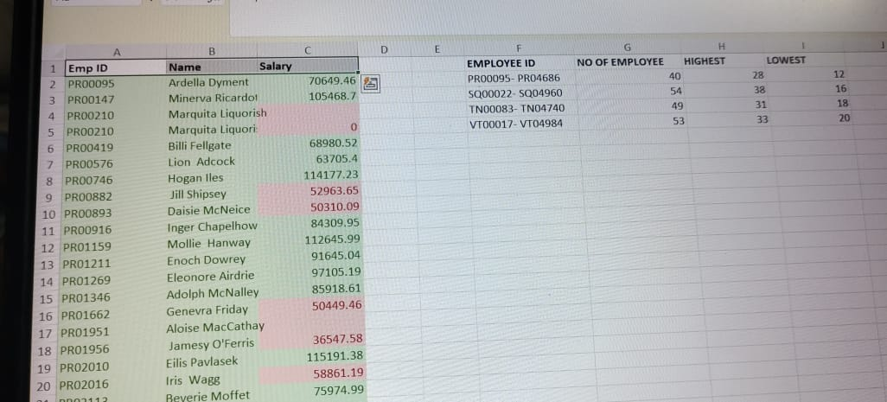

WHO ARE THE END USERS?
Salary among the different employee

Slide 7

OUR SOLUTION AND ITS VALUE PROPOSITION
Sorting- Arrange The Alphabetic Order
Filtering- Remove Missing Value
Conditional Formatting- Highest To Lowest
Pivot Chart- Summary Of Employee Performance
Formulas- Excel Formulas
Graphs- Final Report

Slide 8
Dataset Description
Business Unit: the specific business unit or work locationto which the employee.
Employee ID: PR00095-PR04686, SQ00022-SQ04960, TN00083-TN94740, VT00017-VT04984.
PERFORMANCE: Best in remote area.

Slide 9

THE "WOW" IN OUR SOLUTION
Employee Performance Analysis under Salary Base
Row Labels | Sum of HIGHEST | Sum of LOWEST | Sum of NO OF EMPLOYEE
PR00095- PR04686 | 28 | 12 | 40
SQ00022- SQ04960 | 38 | 16 | 54
TN00083- TN04740 | 31 | 18 | 49
VT00017- VT04984 | 33 | 20 | 53
Grand Total | 130 | 66 | 196
The wow factor consist the salary from the highest from the lowest as per the above table . I used the pivot table & chart.
3/21/2024 Annual Review
9

Slide 10
MODELLING
Data Set: employee dataset
Feature selection: work location
Data Cleaning: missing value, irrelevant
Formula-performance calculation, low, medium, high, sum
Pivot table and chart: summary, business unit, geneder, employee type, employee ID, performance.
Chart : Pie, Bar, Line, Pivot chart.
10

Slide 11
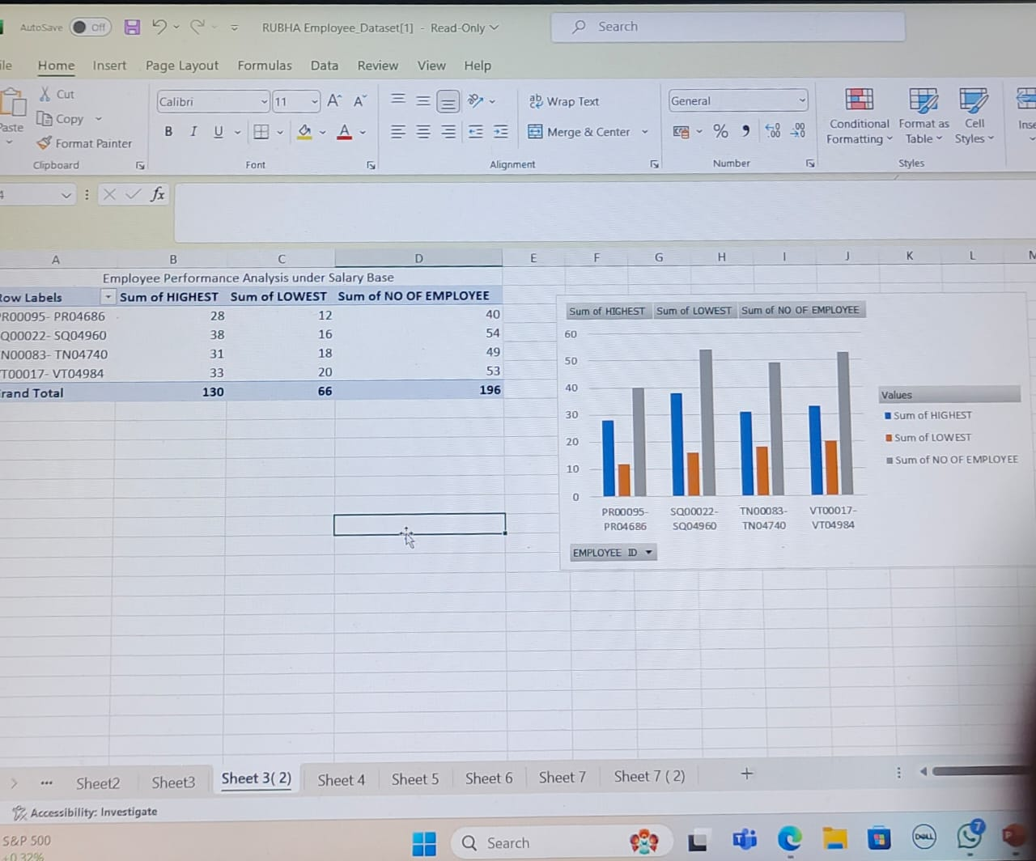
RESULTS
11

Slide 12
Conclusion
The main aim to analysis the employee performance through the salary base from the higher and lower salary, male and female have been equalised in the concern and the performance basis are more in the remote work location.

